Slide 1
A wOBA-Inspired Metric For Defensive Line Evaluation
By: Sam Chinitz

Slide 2
Contents
Slide 3: Assumptions
Slides 4-6: Evaluation Method
Slides 7-9: Final Answers
Slides 10-11: Limitations
Slide 12: Future Analysis
Slide 13: Notes

Slide 3
Assumptions
The term “defensive lineman” is broken down into four positions:
Right defensive end (R DE)
Right defensive tackle (R DT)
Left defensive end (L DE)
Left defensive tackle (L DT)
Defensive linemen responsibilities do not extend to coverage of receivers, so linebackers are not included
Two primary factors determine the value of a defensive lineman
Frequency of production: how often the lineman impacts plays
Effectiveness of production: how the lineman’s impact affects the defense’s ability to limit points

Slide 4
Introducing Adjusted EPA Average (aEPA)
To combine the frequency and effectiveness of a defensive lineman’s performance into one useful metric that describes their value in terms of points, EPA was adjusted to create Adjusted EPA Average (aEPA)
aEPA considers the frequency and effectiveness of defensive linemen production by only giving credit when the lineman directly impacts the play. Direct impacts include:
Tackles (solo and assisted)
Pressures
Sacks (solo and assisted)
Pass breakups
Interceptions
Forced Fumbles
Recovered Fumbles
If a lineman directly impacts the play, then they are credited with negative (good) aEPA. If a lineman does not directly impact the play, then they are credited with 0 aEPA

Slide 5
Adjusted EPA Average In More Detail
The formula for aEPA is:
aEPA = (D - C)/N
Where:
D is the average EPA on plays that the defensive lineman directly impacts
C is the worst defensive EPA from the season (+6.8 in the data)
This adjusts the EPA scale so that the least valuable defensive play is worth 0 aEPA
N is the total number of snaps the player was on the field for, excluding penalties

Slide 6
Adjusted EPA Average Example
Player A has played 100 snaps excluding penalties. He directly impacted the result of the play on 10 of those snaps. The EPA of the plays on those 10 snaps averaged out to -2.0, and the worst defensive EPA for the season was +7.0.
Player A’s aEPA = (-2 - 7)/100 = -0.09
If Player A directly impacted more than 10 plays (more frequent production), or if his production was more effective (the average EPA on the 10 snaps with direct impact was less than -2.0), then his aEPA would decrease (improve). Similarly, if Player A had a lower frequency of production or if his production was less effective, his aEPA would increase (worsen).

Slide 7
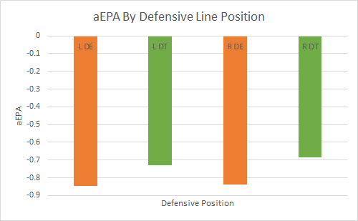
Using aEPA To Asses Positional Value
Instead of calculating aEPA by player name, aEPA was calculated by defensive line position, yielding the following results:
Defensive ends are more valuable than defensive tackles
Linemen on the left side of the field are more valuable than those on the right
Position (Value Rank) | aEPA Average
L DE (1) | -0.846
R DE (2) | -0.839
L DT (3) | -0.731
R DT (4) | -0.684

Slide 8
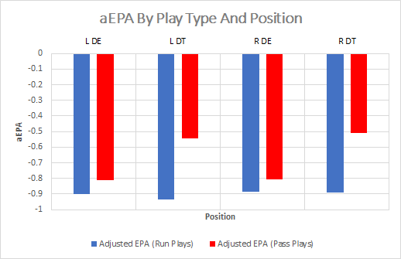
Positional Value By Play Type
The values of defensive line positions fluctuate based on the kind of offensive play
All D-line positions are more valuable on run plays than pass plays, but defensive tackles see the largest variation in value based on play type
On run plays, L DTs are the most valuable defensive line position
On pass plays, L DEs are the most valuable defensive line position
Position | aEPA (Run Plays) | aEPA (Pass Plays)
L DE | -0.900 | -0.809
L DT | -0.937 | -0.546
R DE | -0.884 | -0.807
R DT | -0.888 | -0.508

Slide 9
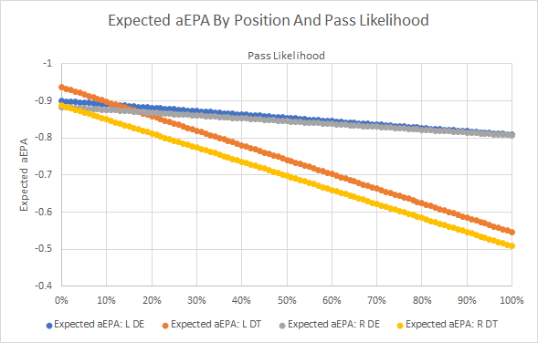
Positional Value By Game Situation
Sharp Football Stats provides Run:Pass ratios that can be used to determine positional value by game situation and opposing roster construction
For example, the 2019 49ers ran the ball 65% of the time on 1st and 10. In this situation the expected aEPA of a L DT is:
(0.65 * L DT aEPA on Run Plays) + (0.35 * L DT aEPA on Pass Plays), which becomes...
(0.65 * -0.937) + (0.35 * -0.546) = -0.800
That logic allows for a sliding scale of positional values based on game situation and opposing personnel. Positional values by every Run:Pass ratio can be found here
L DT is the most valuable position in situations where the likelihood of a pass is less than 13%. In situations where the likelihood of a pass is 13% or higher, L DE is the most valuable position

Slide 10
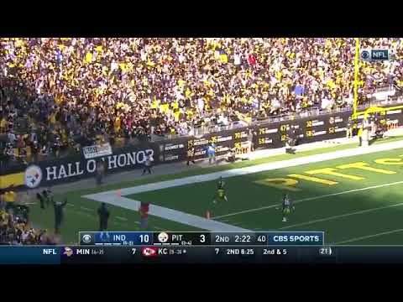
Limitation 1: Team Performance
aEPA for an individual is not completely divorced from team performance. In particular, value derived from pass breakups and pressures can be influenced by teammates
In the video on this slide, Cam Heyward is credited with -18 aEPA because of Heyward’s pressure and Minkah Fitzpatrick’s 96-yard pick-six.
By tying Heward’s (DE) value to Fitzpatrick's (S) production, aEPA does not completely isolate the production of defensive linemen from the production of their teammates
Less than 0.5% of plays in the data set resulted in interceptions with direct impacts from defensive linemen, so this limitation is unlikely to significantly affect the results
One possible way to remedy this is to average the EPAs of all plays with pressures and pass breakups (separately). When a lineman pressures a QB or breaks up a pass, they are credited the the value of an average pressure or breakup rather than the value of the actual play.
This was not pursued because of the possibility that pressures and pass breakups are not created equally. A stronger pass-rusher might have more valuable pressures, and breakups may be more valuable if deflected up (with the chance for an interception) rather than into the ground. See more on Slide 12

Slide 11
Limitations 2 and 3: Indirect Production and Inclusion of Pass Coverage
aEPA treats everything besides direct production as a negative, but a defensive lineman can be productive indirectly
Indirect production might include:
Drawing double teams that make it easier for other defensive linemen to produce directly
Deterring styles of play
For example, a team may run the ball less frequently when facing a particularly tough defensive tackle
aEPA struggles to evaluate players who are required to cover receivers
A significant part of strong pass defense is the ability to deter the QB from throwing the ball to his receiver
Although not an issue for this project, correctly valuing pass coverage could allow for a better overall understanding of the value of defensive line positions

Slide 12
Future Analysis
Investigate the year over year stickiness of pressure and pass breakup value by player
If the values are sticky, then it’s likely that the values of pressures and pass breakups are skills, and aEPA is currently treating those appropriately
If the values are not sticky, then it’s likely that the values of pressures and pass breakups are mostly teammate influenced, and aEPA should be revised
With data on dropped interceptions, credit defensive linemen with the EPA of a turnover and 0 gained yards in plays with dropped picks and direct defensive line production
In fact, all plays with turnovers forced by non-defensive linemen and with a defensive lineman credited for the turnover through aEPA should have the aEPA revised as if the turnover yards were 0. This adjustment requires a formula for EPA
This wouldn’t perfectly isolate defensive line production, but it helps mitigate the impact of teammate performance on the value of defensive line production
Determine the value of drawing double-teams by assessing production of other linemen when one lineman is double teamed. Consider that value in aEPA
Requires data on offensive line double-teaming

Slide 13
Notes
Rows 70187-70191 in the data do not have an associated EPA with the play. John Cominsky (L DE) directly impacted the play with a pass breakup and was credited with -6.8 aEPA, as if the actual EPA on the play was 0. This undervalued Cominsky’s (and the L DE position’s) actual performance on the play, but gives some credit and is unlikely to have had a significant effect on the results
Players with NULL side of ball values were not considered defensive linemen for that particular play
NULL values account for only about 5% of the total side of ball values for defensive tackles and defensive ends

